Slide 1

Capstone Project
Group 5 – Black Widow
Notes:
Bella

Slide 2
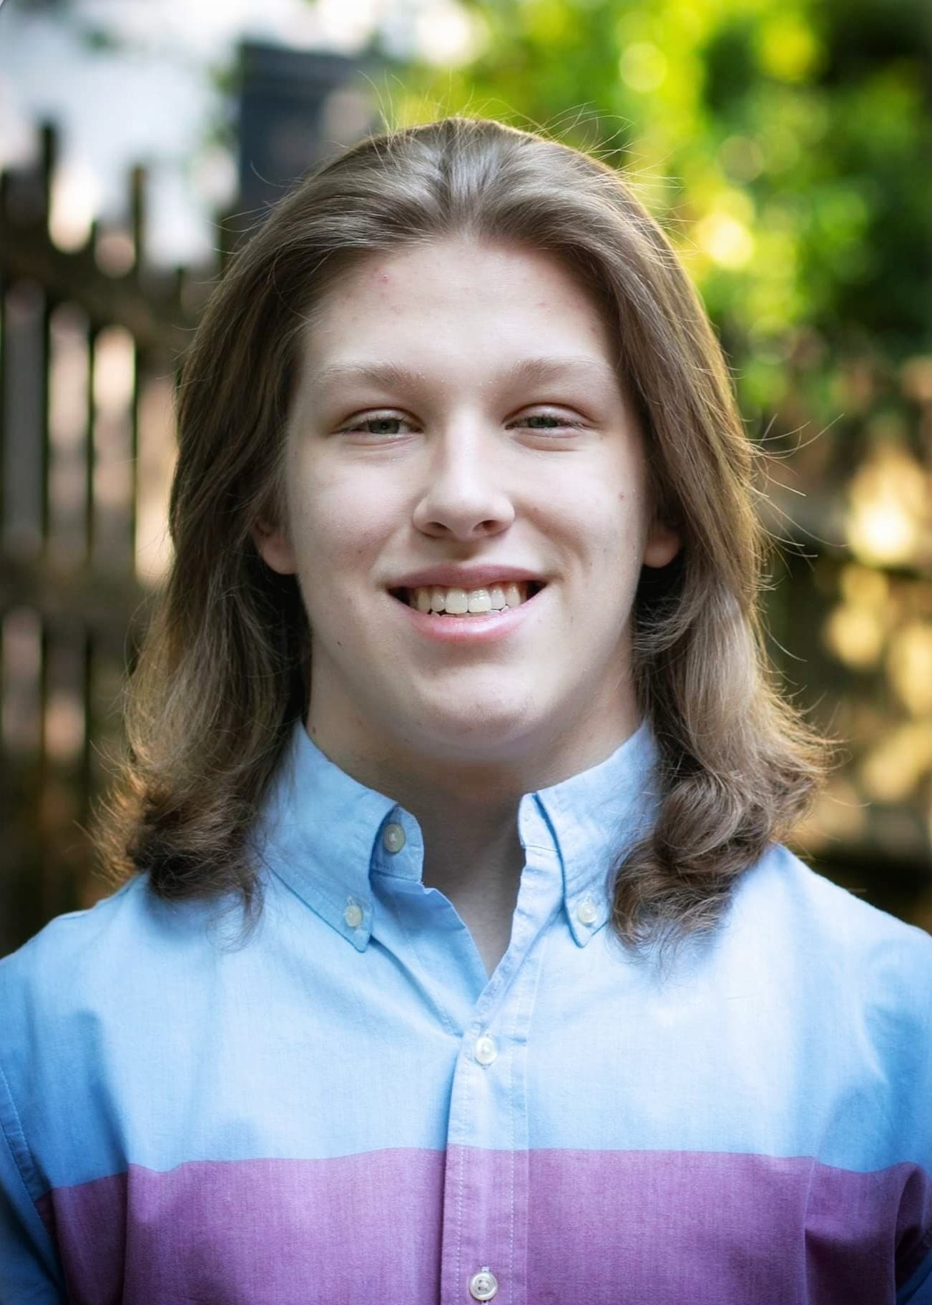
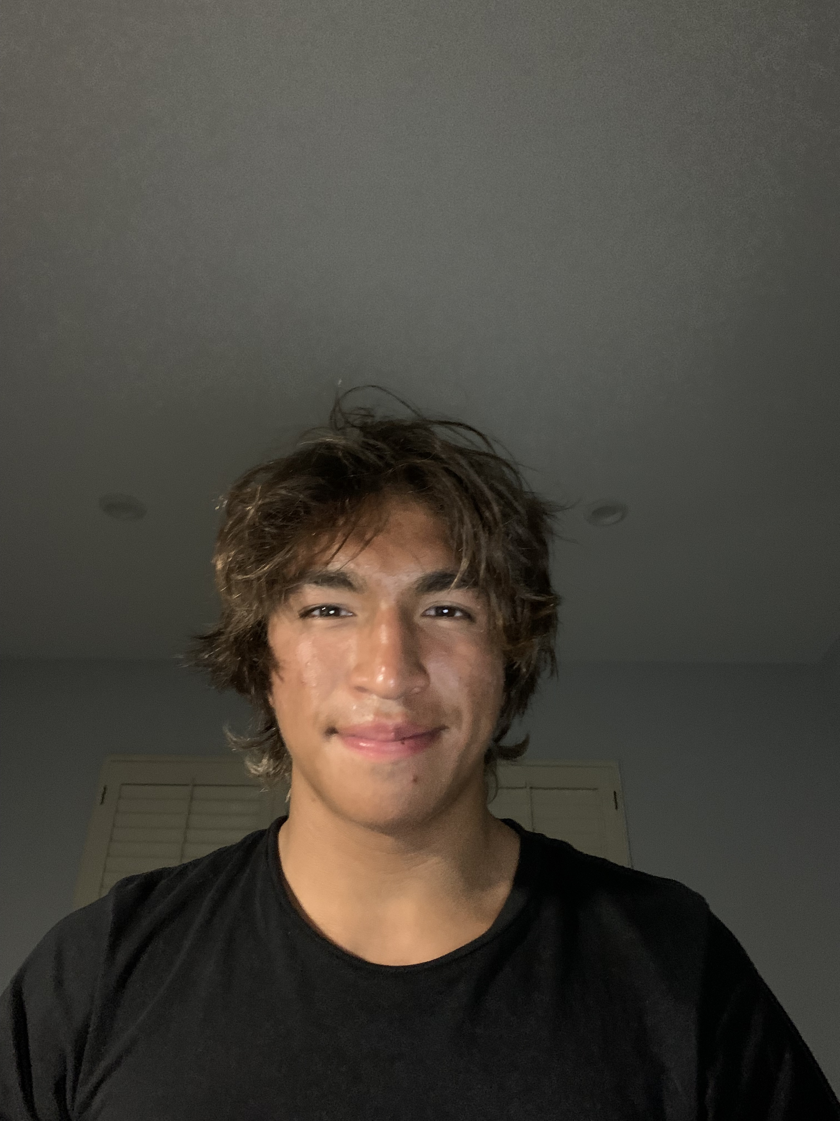
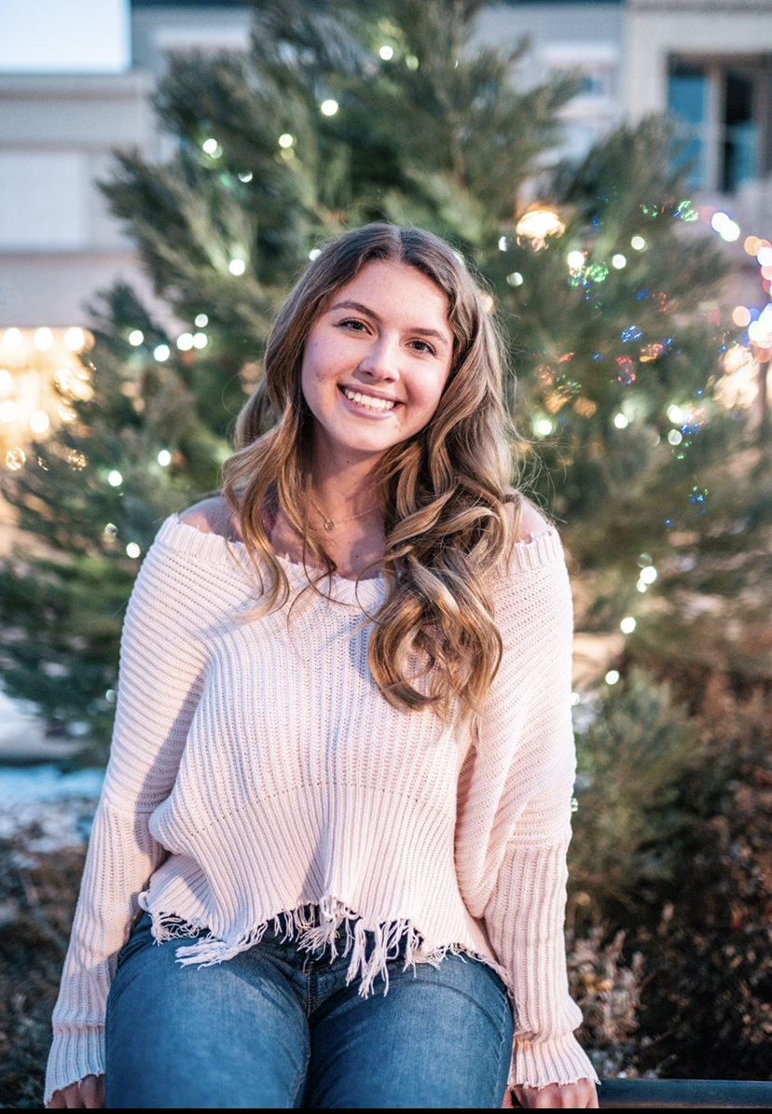
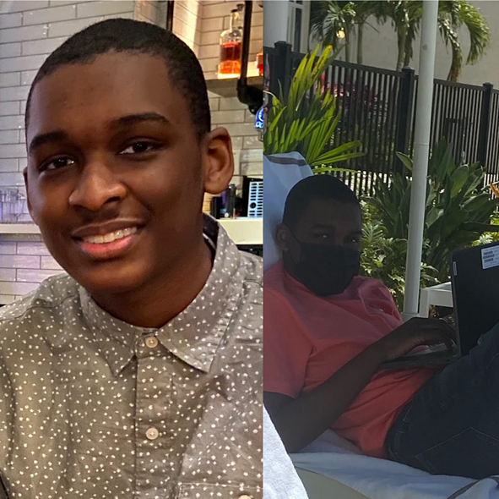
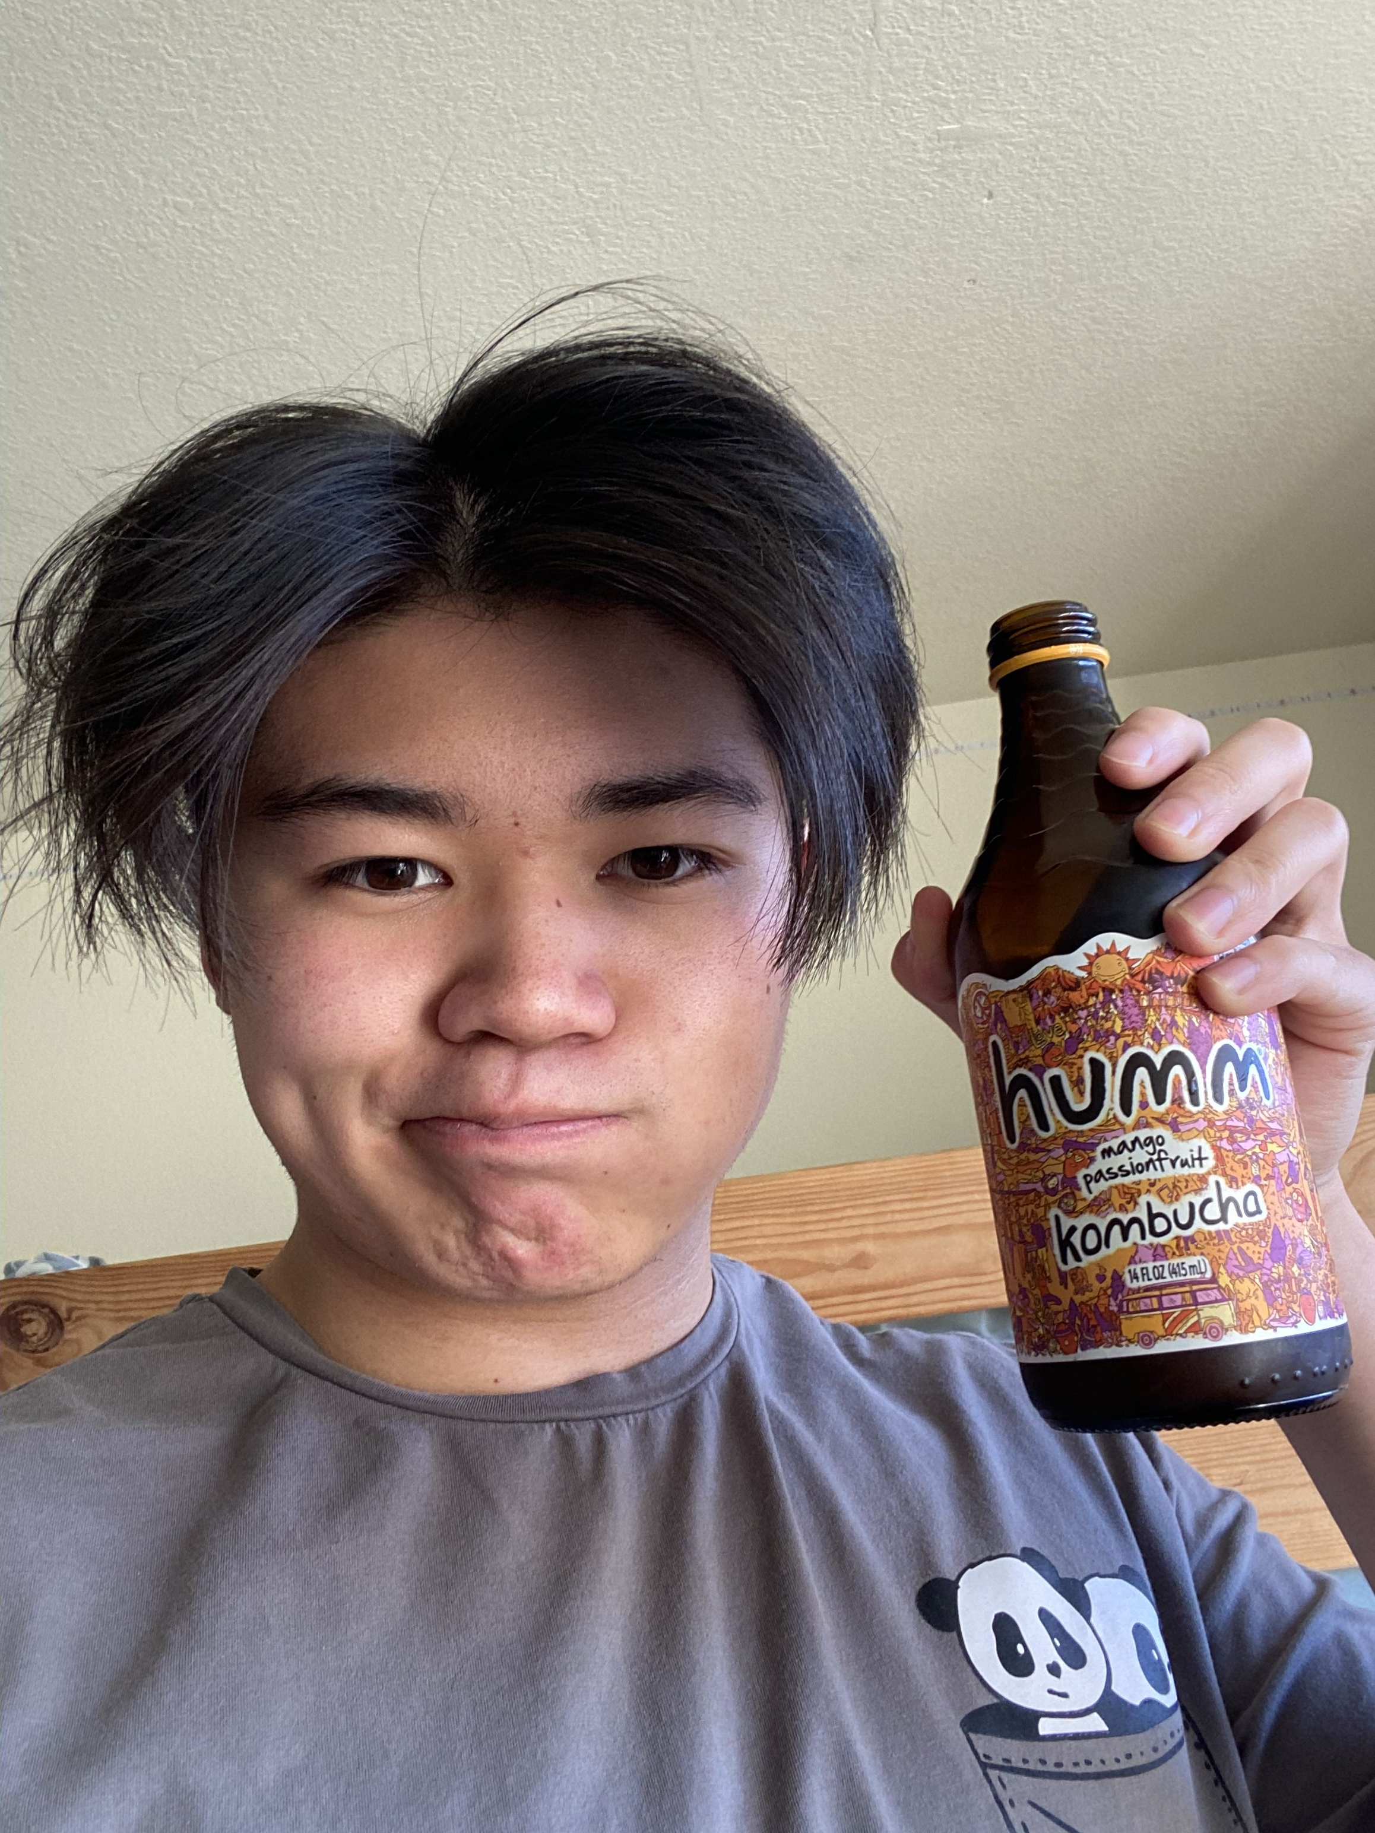
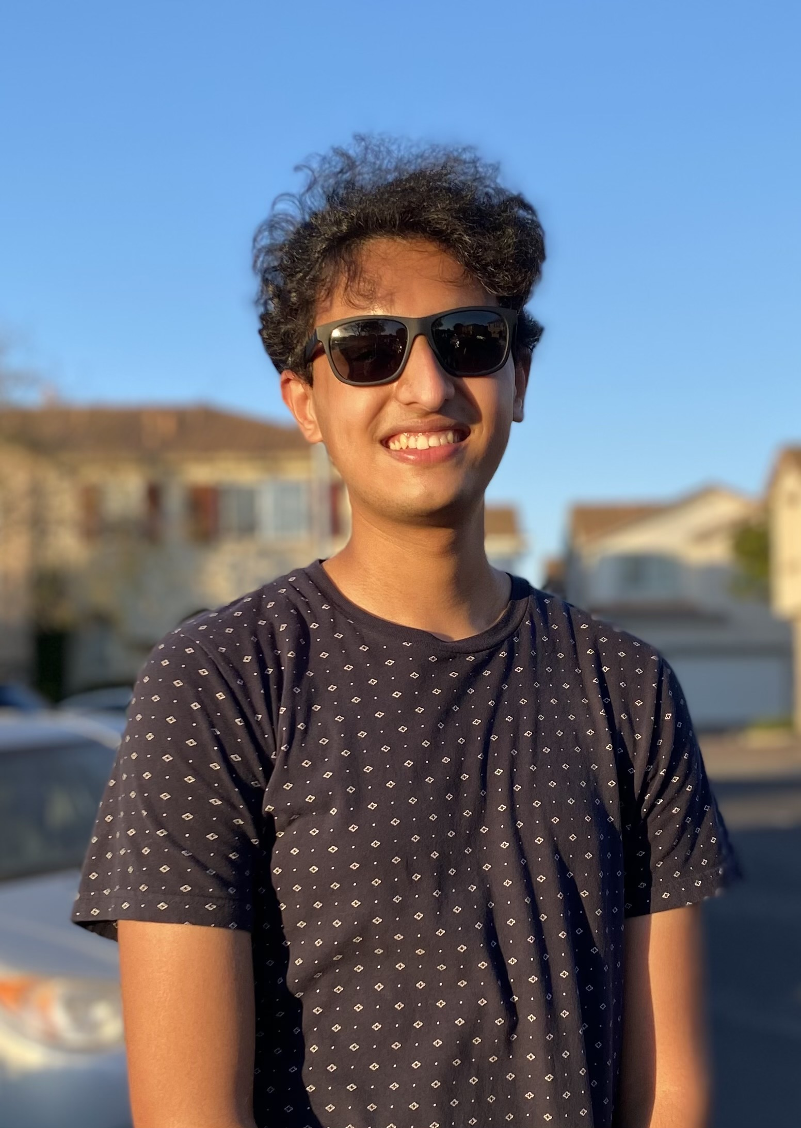
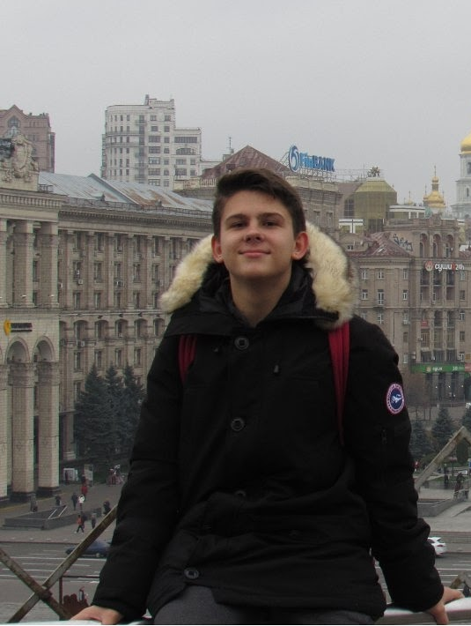
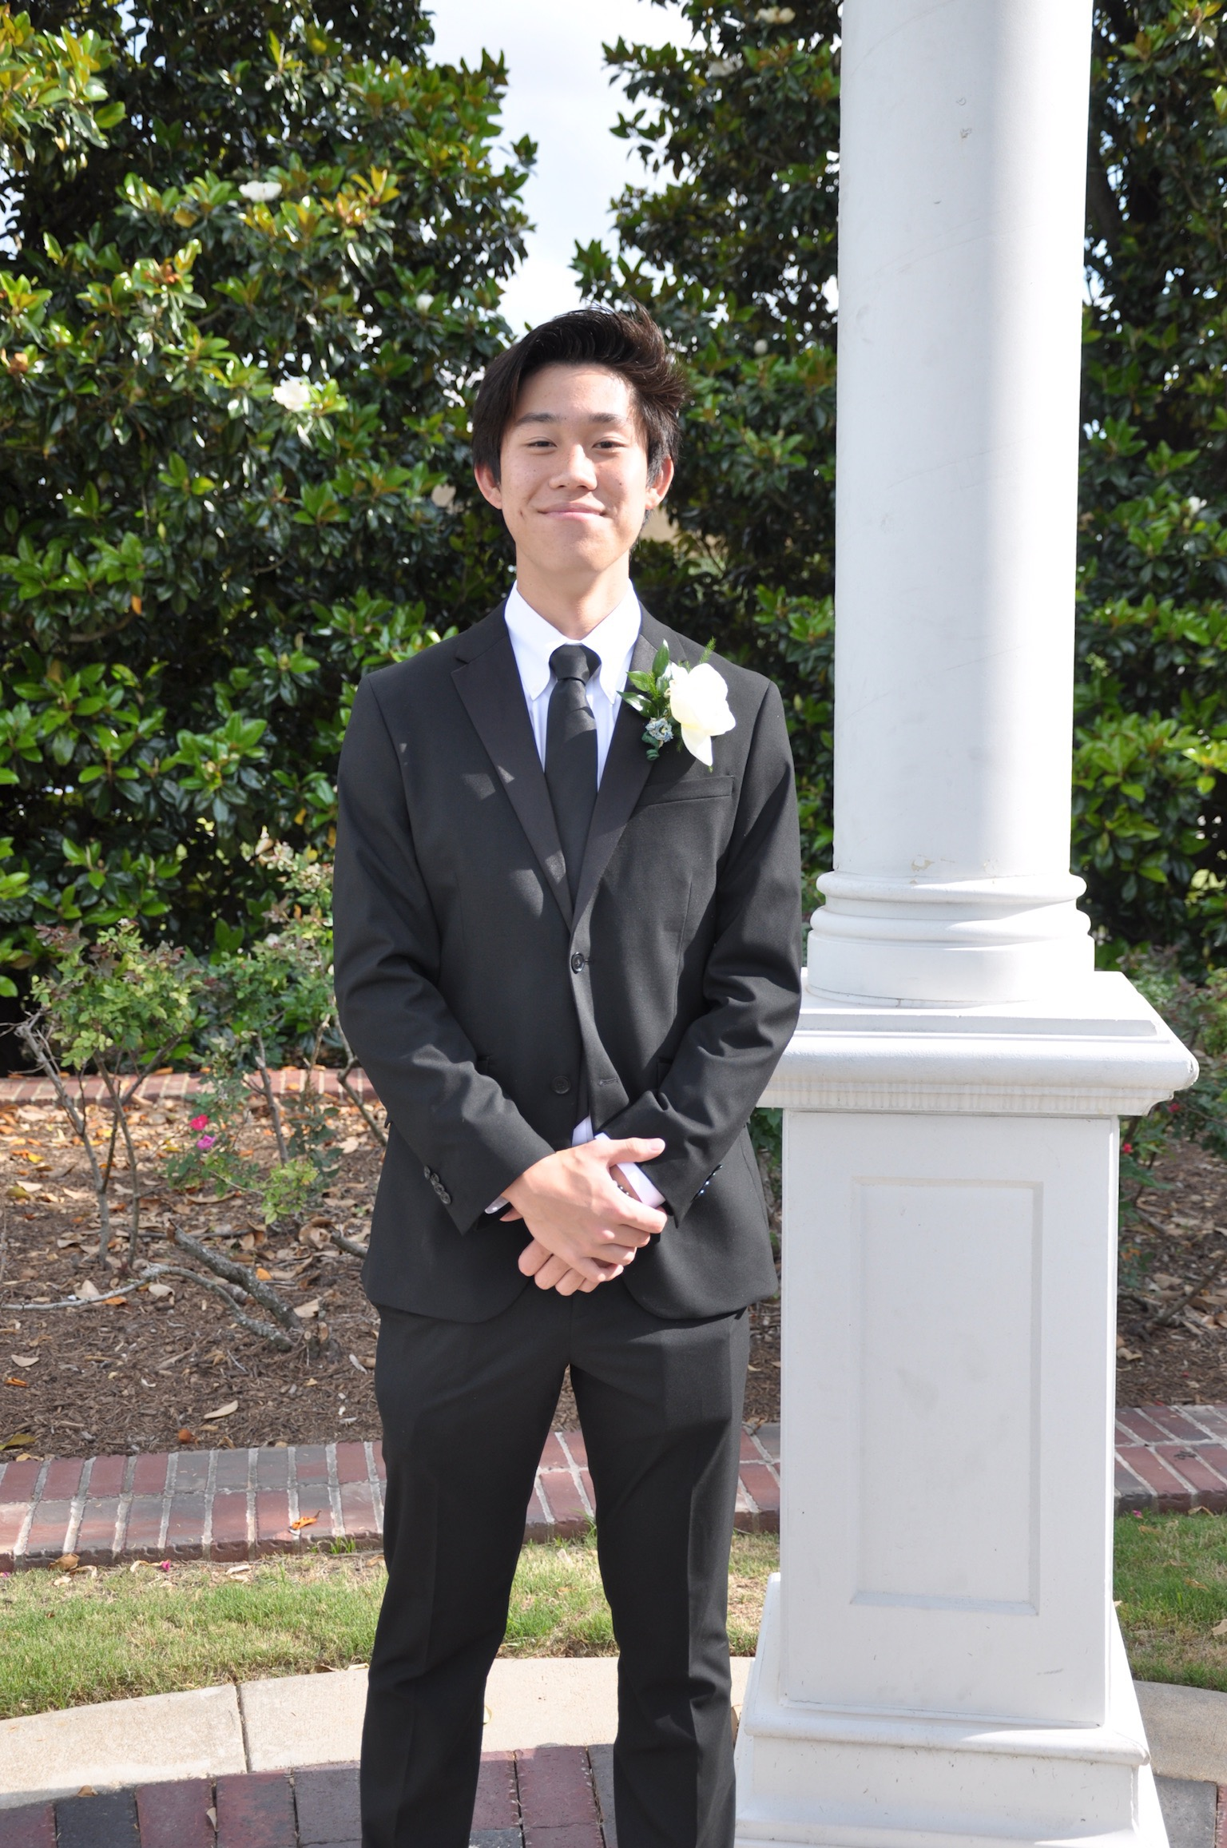
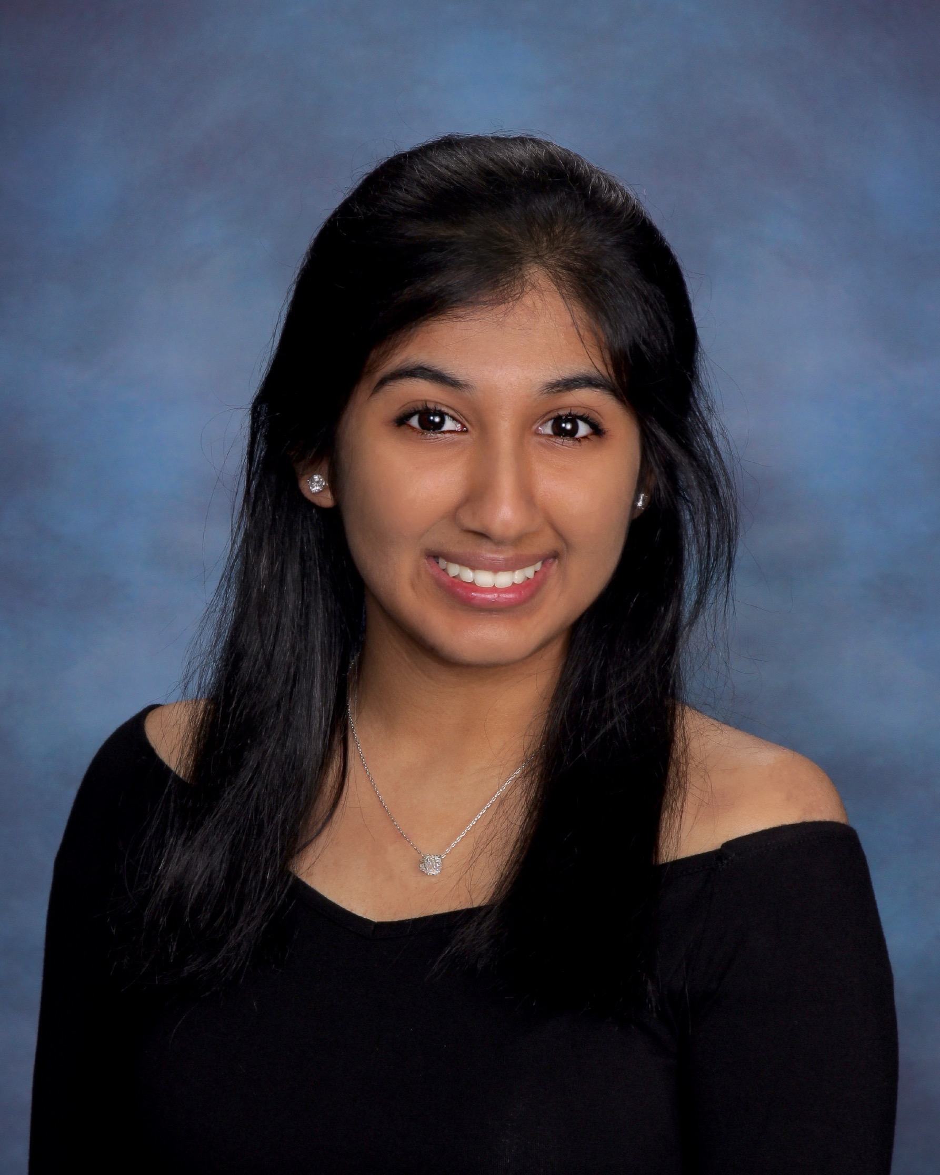
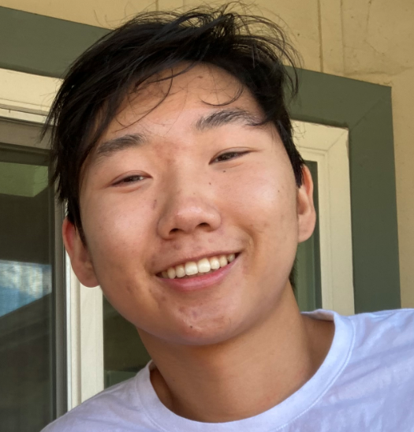
Our Group
Ameer Sulyans
Edward Silva
Marcus Robles
Bella Gigoux
Jeffrey Wei
Kevin Shim
Rushil Gupta
Sasha Humeniuk
Dylan Halim
Tia Kachalia

Slide 3
Agenda
What is the Problem?
Our Solution
Questions
Product Description
Tech Behind Product
Specifications
Ask us Anything About our Project!
Who we are Helping
Real World Data
Our Objective
Our Future
Our Reasoning
Product Thought Process
Future Plans
Areas of Advancements
Notes:
Bella
Audience (elderly people/healthcare providers, chronically ill)
The WHY (real reason why we care about this)

Slide 4

Our Question
?
How can technology be used to manage the medications adherence for chronic care patients and/or multiple medication schedules for the elderly?
Notes:
Dylan

Slide 5

Objective
Goal: Create a product that manages the medication schedule of geriatric patients.
Our product will:
Provide notifications to consumers about their daily medications
Include medication security
Incorporate medicine accuracy
Enable medication dispensing per physician and pharmacology recommendations
Notes:
Dylan

Slide 6
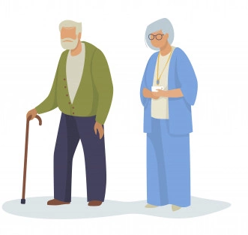
Geriatric Consumer’s
Challenges With Medication Management
With age comes the increased need for medicine.
Elderly grow weary and forgetful of consuming pills (e.g. Alzheimer's disease)
Health issues including blurred vision and impaired hearing can disrupt communication between patients and care team.
Notes:
Sasha
Let’s review some of the challenges that elderly people face with medication management and medication adherence.
As we get older, we might need more and more medicine to improve our overall well being or treat specific symptoms
It can be challenging for elderly people to keep up with their medication schedules, especially when it consists of 4 or more pills for daily consumption.
Health issues such as blurred vision and impaired hearing can disrupt communication between patients and doctors. These miscommunications can be a cause of medication overdose or underdose and lead to serious health consequences.
Story about my father with a lot of medcine, notepads, etc.

Slide 7
Statistics
Statistics
Over of elderly are non-compliant with their prescription drug orders
55%¹
According to the CDC, three major prescription² drug classes caused ~60%³ of drug related hospitalizations
of elderly patients who misuse prescriptions receive painkillers from more than one doctor
70%⁴
¹ https://www.agingcare.com/articles/medication-problems-elderly-people-have-146111.htm#:~:text=Fifty%2Dfive%20percent%20of%20the,due%20to%20adverse%20drug%20reactions.
² Being blood thinners, diabetes agents, and opioids
³ https://www.agingcare.com/articles/senior-drug-overdose-148701.htm
⁴ https://www.aarp.org/content/dam/aarp/ppi/2017/07/prescription-drug-abuse-among-older-adults.pdf
Notes:
Marcus

Slide 8
Our Solution...
Notes:
Ameer

Slide 9

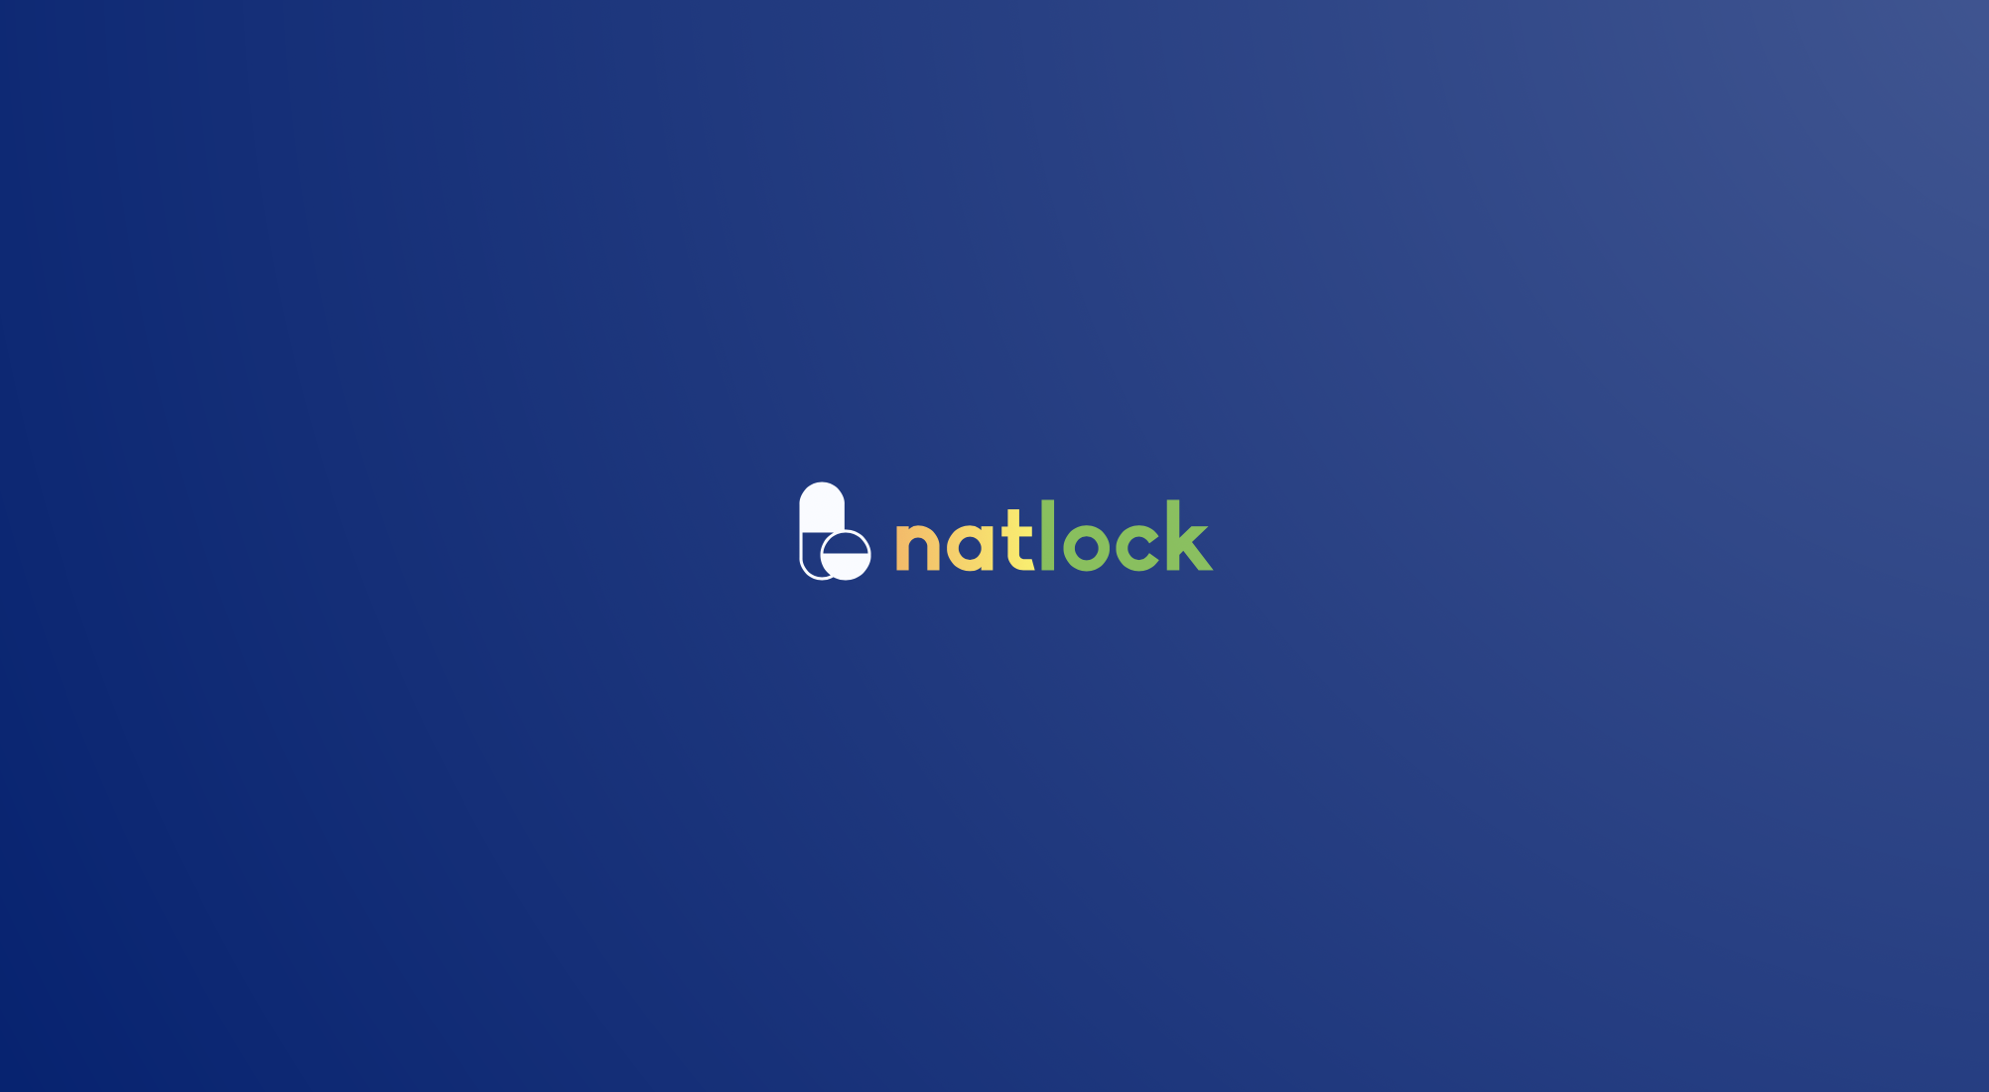
Notes:
Ameer - explain why we chose the name

Slide 10


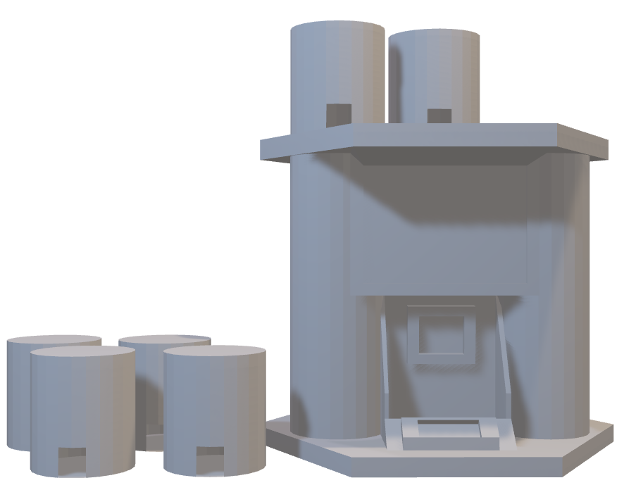
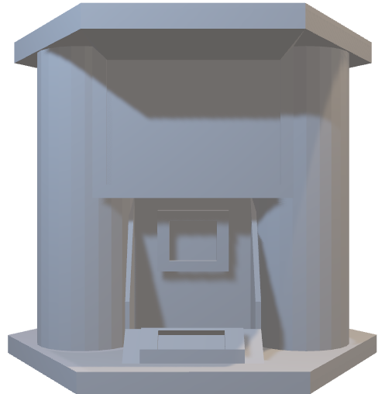
Notes:
Natlock is a hub for

Slide 11

What is natlock?
?
?
?
Reminds the patients daily to take the right amount of pills at the correct times
Features an SOS button
Secure because pills are locked by code chosen by care team
Improve the quality of life for people with chronic illness
Notes:
Ameer

Slide 12

Primary Features
Medication dispenses in accordance with prescription schedule (e.g. twice a day)
Audio notifications via built-in speakers
Visual Notifications via LEDs & LCD Touchscreen
Internal environmental monitoring to preserve medication
Emergency SOS button sends notification to care team
Notes:
Edward

Slide 13
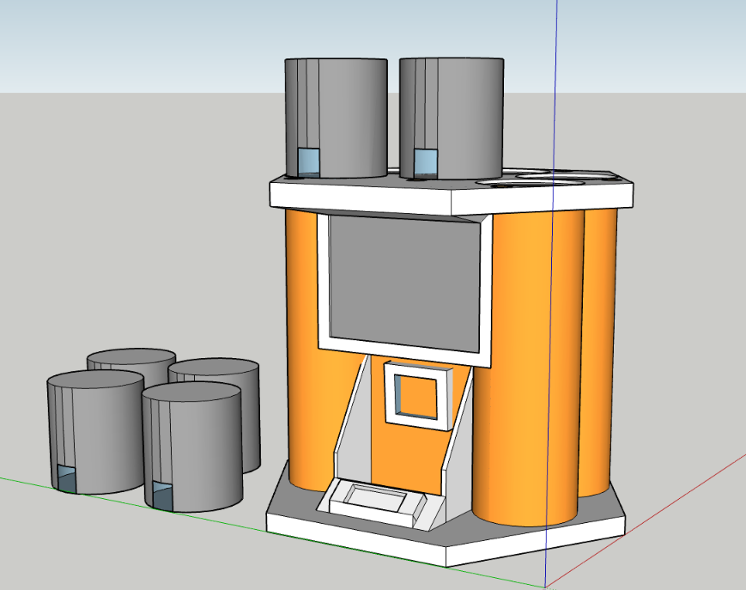
Technology Behind natlock
Temperature + humidity sensor with LED
LCD Screen + Raspberry Pi
Push-to-open
6 Refillable Capsules
Magnet Lock Door
SOS with Protective cover
On-Board GPS
2 ¼” x 1” Standard Pill capsule
Notes:
Edward

Slide 14
LCD Screen UI
Medication Times
PIN
Refill Date
Lock
Medication Restraints
Unlock
Access Medicine
Lock
Medication Schedule
Temperature/Humidity
Settings
General
Dietary Restraints
Current Pill Amount
Notes:
Rushil

Slide 15

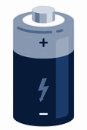

Energy Usage
natlock uses two rechargeable D batteries.
Patients can fully charge both batteries overnight, and they can run for up to 36 hours until recharged.
Through sound and text notifications, natlock will let the patient know when the batteries are running low on power ahead of time.
Notes:
Sasha
Natlock uses two rechargeable D batteries, which is a great choice of power supply for complex technology that our device uses,
These batteries can be fully charged overnight, and run for up to 36 hours until recharged.

Slide 16
How To Use natlock
Our priority
natlock is catered to your needs
In the loop
Your care team will receive routine updates on your medication usage and status
Stay connected
natlock will remind you of any food/water limitations, medication directions, and dispense your medication at the recommended times
Work with your care team
Your care team will fill natlock’s reusable capsules with your scheduled medication(s)
Setup
Set up your natlock and medication schedule with your care team
Notes:
Tia
We’d like to emphasize how simple it is to use natlock. First, consumers can set up their natlock in a matter of minutes with their healthcare provider. This will allow natlock to follow the schedule for your medication and remain updated on any imperative health information of the patient.
Natlock’s simplistic design allows it to be completely portable. Your preferred pharmacy can easily refill the reusable cartridges within natlock with your medication. Not only do we prioritize the health and safety of our consumers, but it is also important to us that we minimize waste that widely results from the standard medication containers commonly used today.
Any information, limitations, and directions regarding your medication can be formulated into reminders that natlock will inform consumers as necessary. For example, natlock can remind a patient not to eat anything a certain time before taking a medication based on the information provided from their healthcare provider. Natlock will also notify and dispense the consumer’s medication at only the appropriate times to avoid overdose, abuse, and retaking of medication.
Natlock’s technology will allow healthcare providers to securely receive updates from natlock as well as send reminders and information regarding the patient. Through a digital “portal” platform, healthcare provides can constantly stay updated on their patients. Information communicated from natlock can include if medication is taken on time, how much of the medication is left and if a refill is necessary
We prioritize the health and safety of senior and elderly consumers. Technology can largely benefit elderly patients, however, we understand it may be difficult to incorporate into their lives. We ensured natlock’s design allows consumers to be safe through our SOS feature that can be used to ask for help whenever necessary. Patients can choose if the SOS contacts a preferred individual or 911.
We hope our simplistic design, portability, environmentally friendly features, and safety precautions empowers elderly consumers to take their medications through the best experience possible

Slide 17


Why Us?
natlock
Our competitors
GPS tracking
Mobile, allows for travel
Anti-Theft Technology
SOS button, Easy to use
Pill limit, patient can’t overdose
HIPAA Compliance
Lack of portability
Costly subscriptions
Technology not “elderly-friendly”
Expensive, inaccessible
No pill dispensation limit, overdose risk
Notes:
Competitors-Kevin
Our competitors share our mission, however, they fall short in the areas that matter most
Other medication dispensing devices are not portable, limiting where and when they can be used
Some competitors are known to require consumers to purchase subscriptions, further increasing the cost for using the device
Elderly consumers prefer simplistic and easy to use technology, however, other devices include features that are complex and may make the consumer require further assistance
Technology within medicine increases safe usage of medication and improves the quality of healthcare. However, our competitors are known to be expensive therefore making their devices less accessible
Overdose or abuse of medication is unfortunately a common issue. The absence of a pill dispensation limit puts consumers at risk of taking more medication than it is safe to
-Natlock-Tia
- Our GPS tracking feature

Slide 18
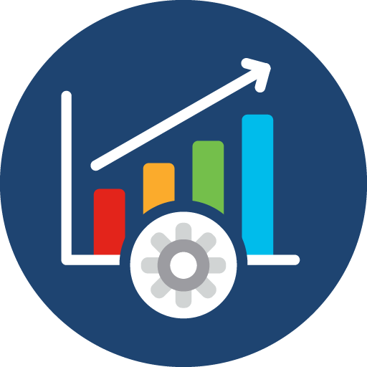
Future Product Improvements
Implementing the DUO mobile app - notification system for emergency contact SOS
Decreasing the size of the device to make it more portable
Prolonged battery life
Improve user interface and notification system based on feedback
Notes:
Kevin

Slide 19
Future Platform Expansion
Increasing accessibility for liquid and insulin doses
Inner-capsule environment tracking
Sustainability for more eco-friendly future
Easier access for different socioeconomic brackets
Multi-year warranty available
Implement affordable subscription models to finance the product’s future endeavors, such as more features
Notes:
Jeffrey
Bridging the financial gap so everyone can access the medicine they need when they need it.

Slide 20

Cost Break Down & ROI
Item | Base Price (retail) COGs/single unit | Base Price COGs @ 10% bulk discount | Customer Price/Single Unit @15% Margin
Biodegradable Filaments | $25.00 | $22.50 | $27.00
Raspberry Pi Zero | $5.00 | $4.50 | $5.40
Mini Touch Screen | $15.00 | $13.50 | $16.20
D Batteries | $2.50 | $2.25 | $3.00
Meraki Temperature Sensor | $30.00 | $27.00 | $32.40
Magnetic Strip | $50.00 | $45.00 | $54.00
GPS Sensor | $40.00 | $36.00 | $43.20
Speakers | $5.00 | $4.50 | $5.40
Sim Card | $5.00 | $4.50 | $5.40
3D Printer ** | $20,000.00 | n/a after initial investment
Total | $20,177.50 | $159.75 | $192
Units | Investment | Profit (assuming no discounts) | Production ROI
1 | $20.000.00 | $32.25 | 0.2%
100 | $20,000.00 | $3,225.00 | 16.1%
1000 | $20,000.00 | $32,250.00 | 161.3%
COST: ** Industrial 3D Printer allows for mass production = more product to sell in a quicker manner/supply generation ** Break Even on investment is ≈621 units Flexibility/Cost Savings ability with different material providers | PRICE: Closest competitors’ price range: $150-$600 (Possible future) Volume Discount to customers Profit $32.25/unit (20% profit margin) | POTENTIAL CUSTOMERS/DEMAND GEN: US Population age 65+ is 40.3M* (*US Census, 2010) # of potential Customers/demand generation potential is high in target demographic Opportunity for additional end-users
Notes:
Bella
COST:
For sake of simplicity of presentation we have assumed all General overhead, such as labor, warehousing, logistics, etc, are included in price points.
Realize cost seems high at first glance. However, industrial 3D printer allows for mass production allowing for quicker supply generation. We do have some flexibility in materials costs based on our preferred material providers, have estimated 10% bulk discount when purchasing COGs.
Break even at 1312 units at a single unit price of $192, but this can and will flex slightly up or down based on materials costs and changes in the market.
PRICE
Closest competitors price similar units between $150 and $600 each, units with a monthly subscription charge tend to be higher starting with a minimal base price but monthly charge. $192 per unit is well within competitive range. We can also offer volume discounts to customers which increases number needed to sell for breakeven but also increases likelihood of multi-unit purchases
JUSTIFICATION based on Investor ROI
US Population over the age of 65 is 40.3M people, according to the 2010 US Census.
The number of potential customers/demand generation potential is high based on this figure within just this target demographic. This doesn’t account for the opportunity for additional end-users in other demographics
We believe a break even point of 621 units, is highly possible considering the total potential customer base

Slide 21
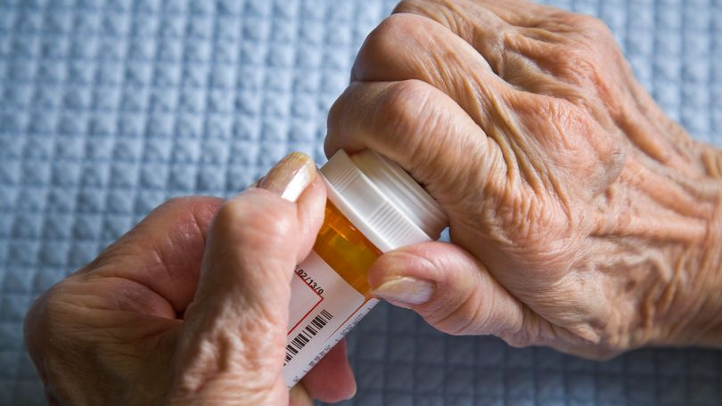
Care for those who you love
Notes:
Jeffrey

Slide 22
Questions?
Notes:
Jeffrey

Slide 23
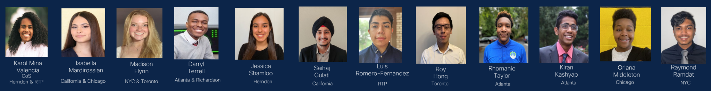
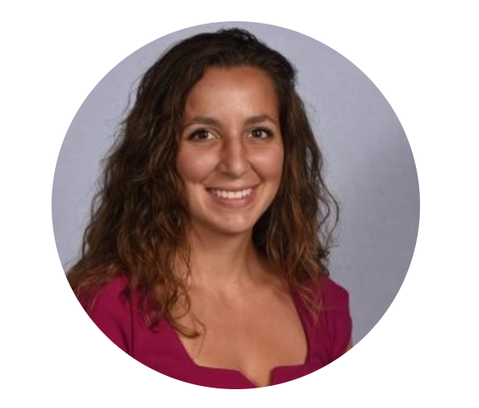
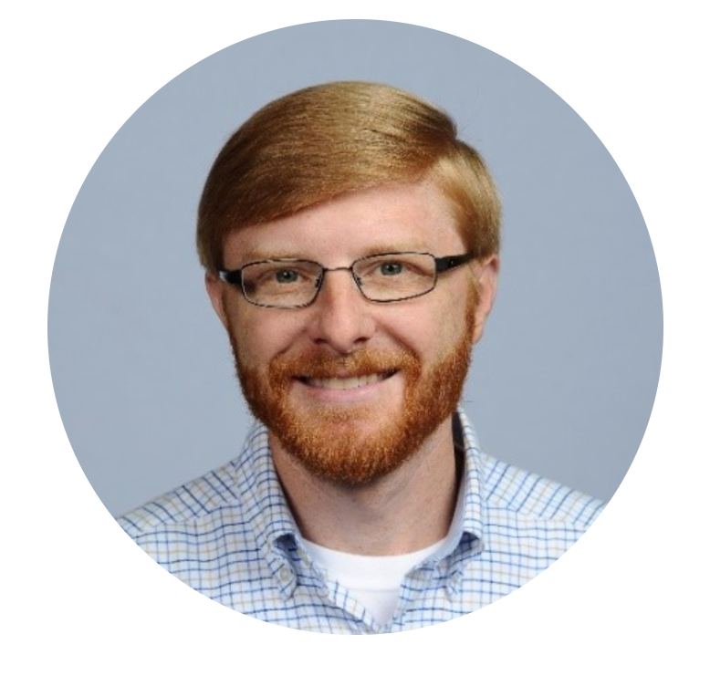
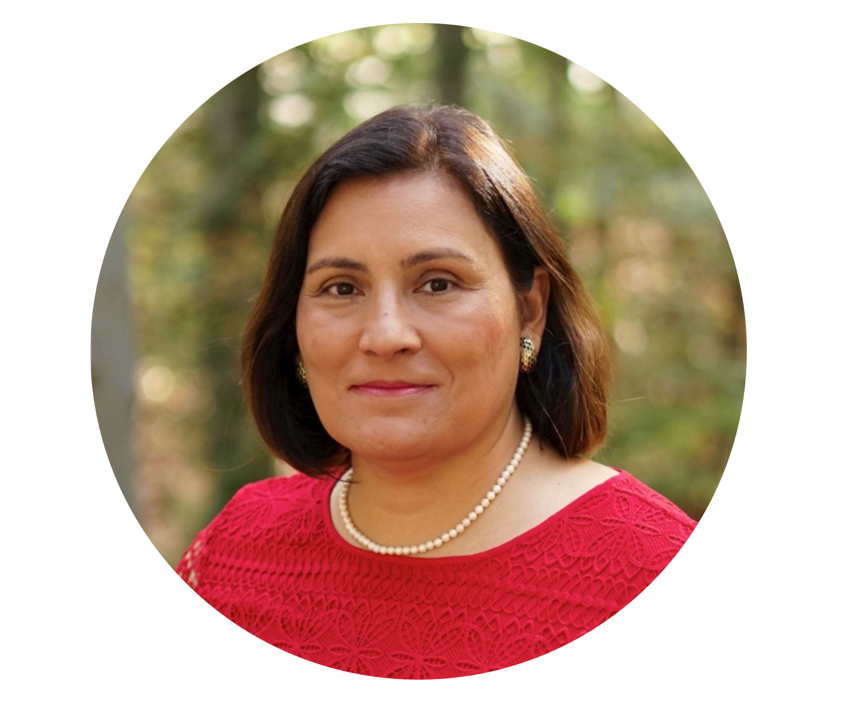
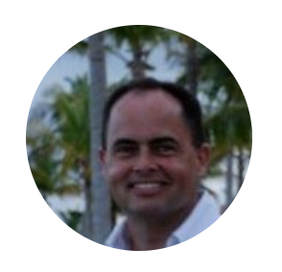
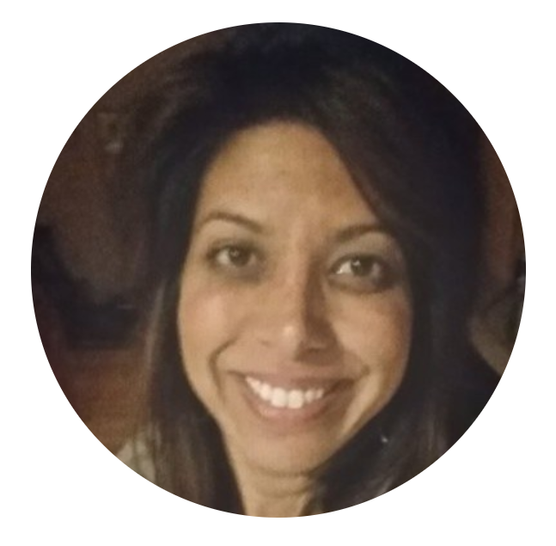
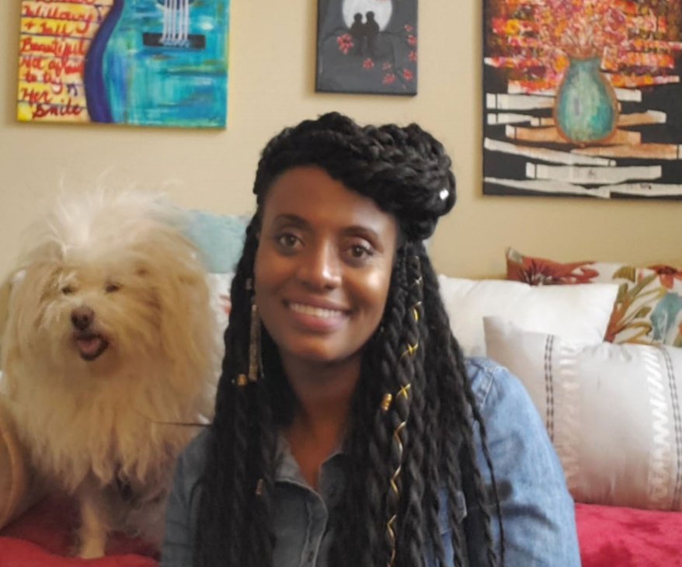

Thank you to all the interns and Cisco Staff for this opportunity!
Special thanks to Nicholle Pelletier, Peter Fischer, Nora Marcos, Randy Benn, Sujata Singhal, and Sweetie Browne!
Notes:
Jeffrey

